Slide 1

GenerativeAI and Its Applications
Unit 1
(UE23CS342BA4)
POS and NER
Dr Pooja Agarwal
Dept. of CSE, PES University, Bangalore

Slide 2
GenerativeAI and Its Applications
Parts of Speech Tagging (PoS)

Slide 3
GenerativeAI and Its Applications
POS (parts of speech)
Parts of speech (POS) are useful because they reveal a lot about a word and its neighbors.
Knowing a word POS(noun or verb, …) tells us about
likely neighboring words (nouns are preceded by determiners and adjectives, verbs by nouns) and
syntactic structure (nouns are generally part of noun phrases), making POS tagging a key aspect of parsing.
Parts of speech are useful features
for labeling named entities(NER) like people or organizations in information extraction, or
for coreference resolution(the task of finding all expressions that refer to the same entity in a text)
for sentiment analysis, question answering, and word sense disambiguation.

Slide 4
GenerativeAI and Its Applications
POS (parts of speech) examples
N noun chair, bandwidth, pacing
V verb study, debate, munch
ADJ adjective purple, tall, ridiculous
ADV adverb unfortunately, slowly,
P preposition of, by, to
PRO pronoun I, me, mine
DET determiner the, a, that, those
Conj conjunctions and, or

Slide 5
GenerativeAI and Its Applications
POS (parts of speech)
Parts of speech can be divided into two broad categories:
Closed class type
Open class type (verbs, adverbs, nouns, and adjectives)
Closed classes No inclusion of new words very often. Closed classes are those with relatively fixed membership, such as prepositions—new prepositions are rarely coined. Like preposition, aux verbs etc
Closed class words are generally function words like of, it, and, or you, occur frequently.
Nouns and verbs are open classes—new nouns and verbs like iPhone or to fax are continually being created or borrowed.

Slide 6
GenerativeAI and Its Applications
POS (parts of speech)
The important closed classes in English include:
Prepositions: on, under, over, near, by, at, from, to, with
Particles: up, down, on, off, in, out, at, by
Determiners: a, an, the, this/that, these/those, its, our, their
Conjunctions: and, but, or, as, if, when
Pronouns: she, who, I, others
Auxiliary verbs: can, may, should, is, are, do, have, ...
Numerals: one, two, three, first, second, third, …

Slide 7
GenerativeAI and Its Applications
Different Corpora and Tree Banks
A corpus is a large and structured set of machine-readable texts that have been produced in a natural communicative setting.
Its plural is corpora.
They can be derived in different ways like text that was originally electronic, transcripts of spoken language and optical character recognition, etc.
Corpora are generally solely used for statistical linguistic analysis and hypothesis testing.

Slide 8
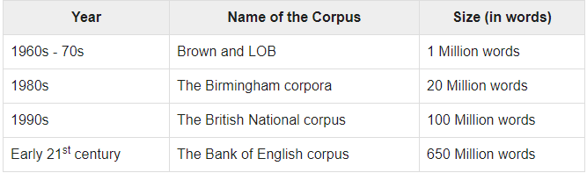
GenerativeAI and Its Applications
Different Corpora and Tree Banks
Brown Corpus is a million word collection of samples from 500 written texts from different genres(like newspapers, novels, non-fiction, academics etc.

Slide 9
GenerativeAI and Its Applications
Different Corpora and Tree Banks
TreeBanks
Linguistically parsed text corpus that annotates syntactic or semantic sentence structure.
Geoffrey Leech coined the term ‘treebank’, which represents that the most common way of representing the grammatical analysis is by means of a tree structure.
Generally, Treebanks are created on the top of a corpus, which has already been annotated with part-of-speech tags.

Slide 10
GenerativeAI and Its Applications
POS (parts of speech)
What are POS tags?
POS tags are also known as word classes, morphological classes, or lexical tags
Number of tags used by different systems/corpora/languages are different
Penn Treebank (Wall Street Journal Newswire): 45 tags
Brown corpus (Mixed genres like fiction, biographies, etc): 87 tags
Lancaster UCREL C5: 61 tags
Lancaster C7: 145 tags
POS tags can be of varying granularity.
Morphologically complex languages have very different tag-sets from English or Dutch.

Slide 11
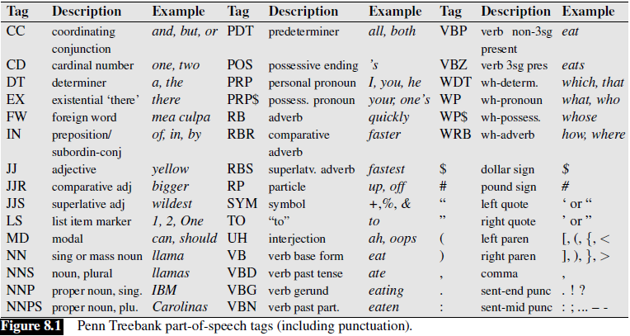
GenerativeAI and Its Applications
POS (parts of speech)

Slide 12
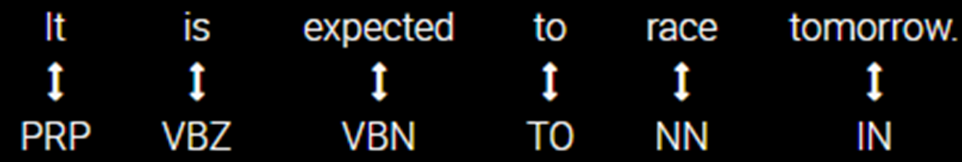
GenerativeAI and Its Applications
POS tagging
Part-of-speech tagging is the process of assigning a part-of-speech marker to each word in an input text.
The input to a tagging algorithm is a sequence of (tokenized) words and a tagset, and the output is a sequence of tags, one per token.

Slide 13
GenerativeAI and Its Applications
POS tagging
Tagging is a disambiguation task; words are ambiguous - have more than one possible POS - and the goal is to find the correct tag for the situation.
For example,
book can be a verb (book that flight) or a noun (hand me that book).
That can be a determiner (Does that flight serve dinner) or a complementizer (I thought that your flight was earlier).
The goal of POS-tagging is to resolve these ambiguities, choosing the proper tag for the context.

Slide 14
GenerativeAI and Its Applications
Why is POS tagging hard?
Ambiguity
“Plants/N need light and water.”
“Each one plant/V one.”
2. “Flies like a flower”
Flies: noun or verb?
like: preposition, adverb, conjunction, noun, or verb?
a: article, noun, or preposition?
flower: noun or verb?

Slide 15
GenerativeAI and Its Applications
Why is POS tagging hard?
Words often have more than one POS
For example, the word back in following sentences:
The back door = JJ(Adjective)
On my back = NN(Noun singular)
Win the voters back = RB(Adverb)
Promised to back the bill = VB(Verb base form)
The POS tagging problem is to determine the POS tag for a particular instance of a word.

Slide 16
GenerativeAI and Its Applications
3 approaches for POS tagging
Rule-based tagging
The ENGTWOL tagger (Voutilainen, 1995) is a rule based tagger based on two-stage architecture.
Transformation-based tagging
Brill tagger
Stochastic (Probability/Frequency) tagging
Most frequent tag algorithm
HMM (Hidden Markov Model) tagging

Slide 17
GenerativeAI and Its Applications
Rule-based tagging (two stage - architecture)
Stage 1:
Start with a dictionary of Tagsets
Assign all possible tags to words from the dictionary exploiting morphological/orthographic rules.
Stage 2:
Write rules by hand to selectively remove tags.
Disambiguation is done by analyzing the linguistic features of the word, its preceding word, its following word and other aspects.
For example, if the preceding word is an article then the word in question must be noun. This information is coded in the form of rules.
Leaving the correct tag for each word.
Example of rules: NP → Det (Adj*) N For example: the clever student

Slide 18
Rule based : Start with a dictionary
GenerativeAI and Its Applications
Rule-based tagging (two stage - architecture)
Example 1:
Personal pronoun
Past participle
she: PRP
promised: VBN,VBD
to TO
back: VB, JJ, RB, NN
the: DT
bill: NN, VB
Past tense verb
Adverb

Slide 19
Write rules to eliminate tags
GenerativeAI and Its Applications
Rule-based tagging (two stage - architecture)
Example 1:
R1: Eliminate VBN if VBD is an option when VBN|VBD follows “<start> PRP”
NN
RB
JJ VB
PRP VBD TO VB DT NN
She promised to back the bill

Slide 20
GenerativeAI and Its Applications
2. Stochastic tagging
The tag encountered most frequently with the word in the training set is the one assigned to an instance of that word.
Word Frequency Approach
Create dictionary with each possible tag for a word
Take a tagged corpus
Count the number of times each tag occurs for that word.
Given a new sentence
For each word, pick the most frequent tag for that word using above.
The main issue with this approach is that it may yield inadmissible sequence of tags.

Slide 21
GenerativeAI and Its Applications
2. Stochastic tagging
Tag Sequence Probabilities – N-gram approach
Probabilities: Tagging with lexical frequencies
Sami is expected to race tomorrow
Sami/NNP is/VBZ expected/VBN to/TO race/VB tomorrow/NN
People/NNS continue/VBP to/TO inquire/VB the/DT reason/NN for/IN the/DT race/NN for/IN outer/JJ space/NN
Problem: Assign a tag to race given its lexical frequency
Solution: We choose the tag that has the greater likelihood
P(race|VB) = Count(race is verb)/Total Count(race)
P(race|NN)= Count(race is noun)/Total Count(race)
In Brown corpus, P(race|VB) = 96/98 = .98 which is higher than P(race|NN)=0.2

Slide 22
GenerativeAI and Its Applications
3. Transformation-based tagging
It is also called Brill tagging.
Brill tagging is an instance of the transformation-based learning (TBL).
It draws the inspiration from both the rule-based and stochastic taggers.
TBL, allows us to have linguistic knowledge in a readable form, transforms one state to another state by using transformation rules.

Slide 23
GenerativeAI and Its Applications
Transformation-based tagging
Basic idea:
First use frequency, then revise it using contextual rule.
The Brill tagger was described and invented by Eric Brill in his 1993. It can be summarized as an "error-driven transformation-based tagger".
The Brill tagger is:
a form of supervised learning, which aims to minimize error and
a transformation-based process, in the sense that a tag is assigned to each word and changed using a set of predefined rules.

Slide 24
GenerativeAI and Its Applications
Transformation-based tagging
In the transformation process,
if the word is known, it first assigns the most frequent tag (may be noun or determiner) or
if the word is unknown, it naively assigns the tag "noun" to it.
Applying over and over the hand written rules ( Rule based tagging), changing the incorrect tags, a quite high accuracy is achieved.

Slide 25
GenerativeAI and Its Applications
Transformation-based tagging
Example:
It is expected to race tomorrow. The race for outer space.
Tagging algorithm:
Tag all uses of “race” as NN (most likely tag in the Brown corpus)
It is expected to race/NN tomorrow
the race/NN for outer space
Use a transformation rule to replace the tag NN with VB for all uses of “race” preceded by the tag TO:
It is expected to race/VB tomorrow
the race/NN for outer space

Slide 26
GenerativeAI and Its Applications
POS Tag using HMM

Slide 27
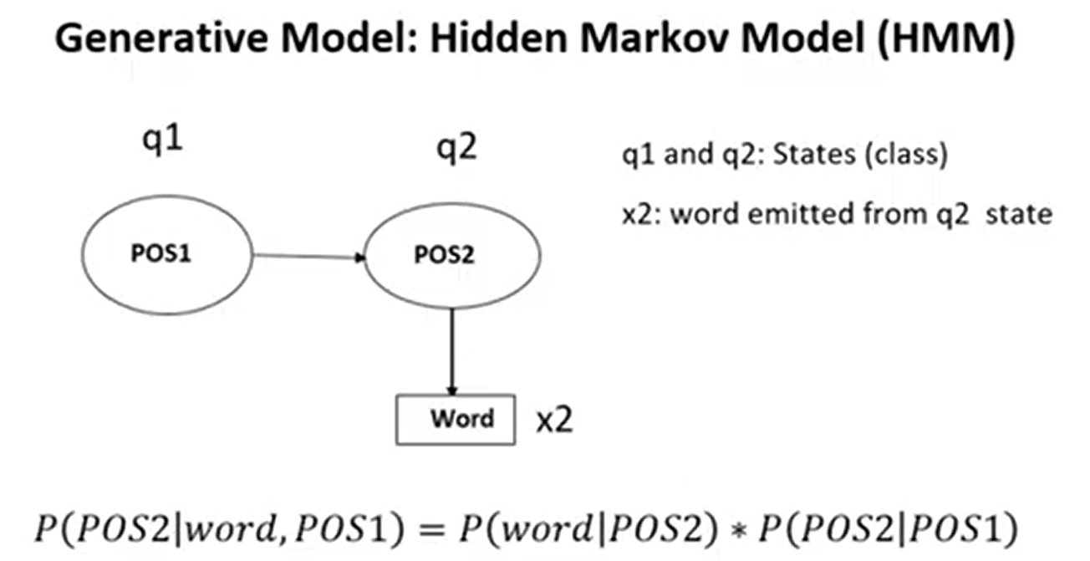
GenerativeAI and Its Applications
POS Tag using HMM

Slide 28
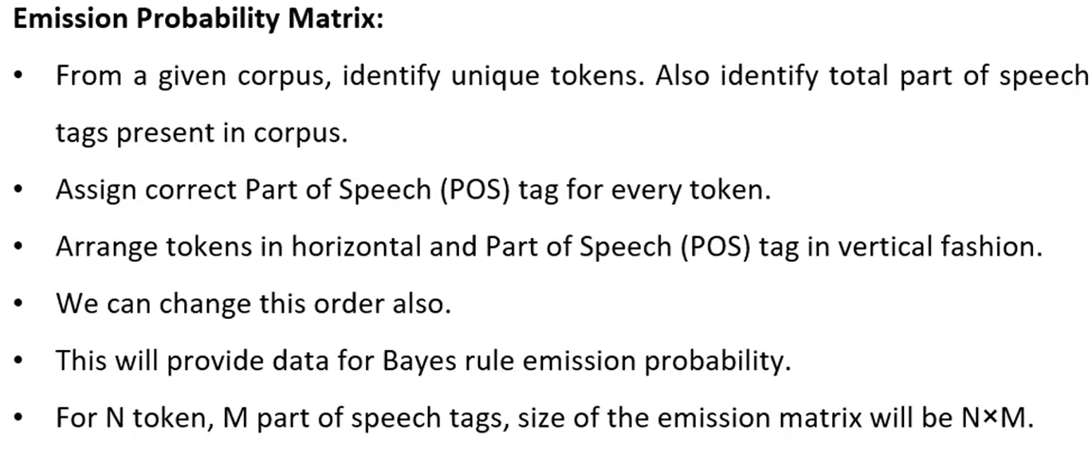
GenerativeAI and Its Applications
POS Tag using HMM

Slide 29
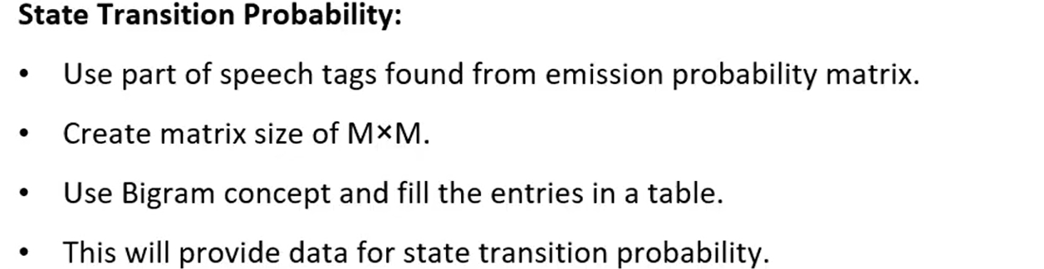
GenerativeAI and Its Applications
POS Tag using HMM

Slide 30
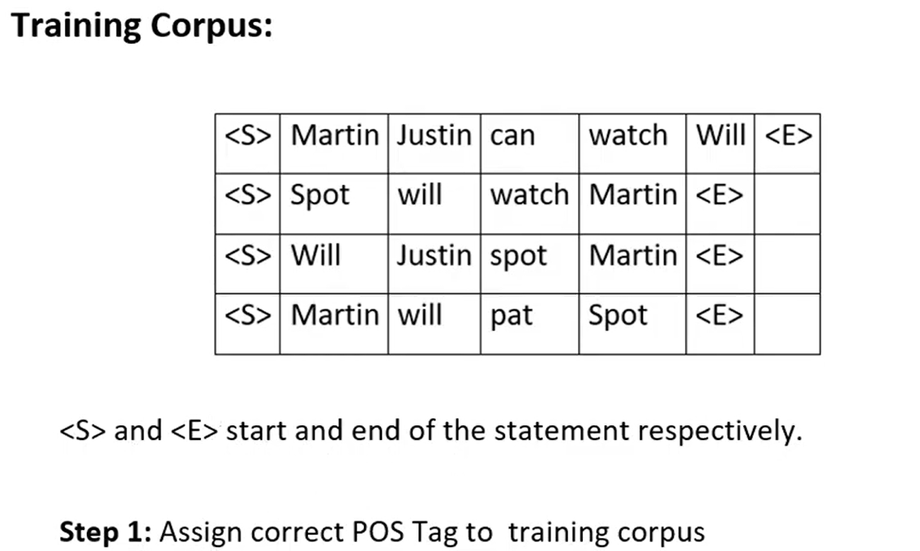
GenerativeAI and Its Applications
POS Tag using HMM (Example)

Slide 31
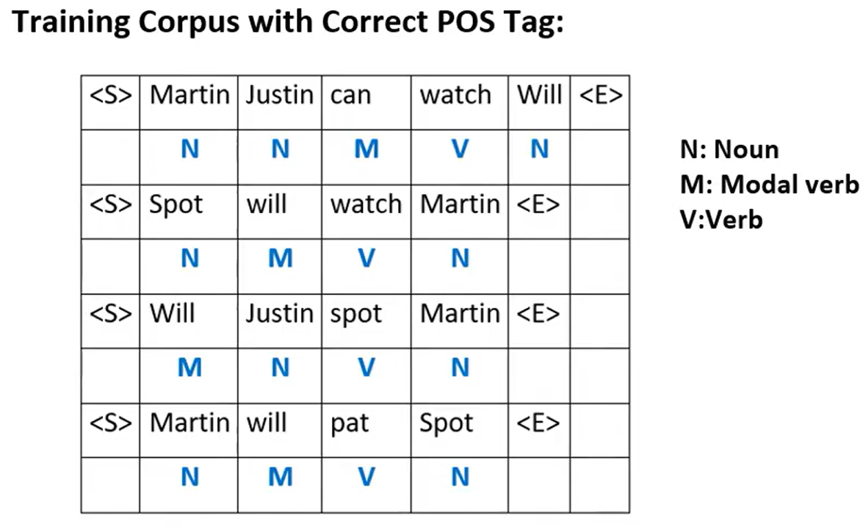
GenerativeAI and Its Applications
POS Tag using HMM

Slide 32
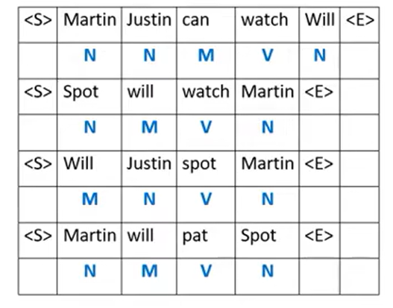
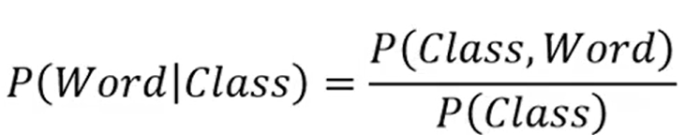
GenerativeAI and Its Applications
POS Tag using HMM

Slide 33
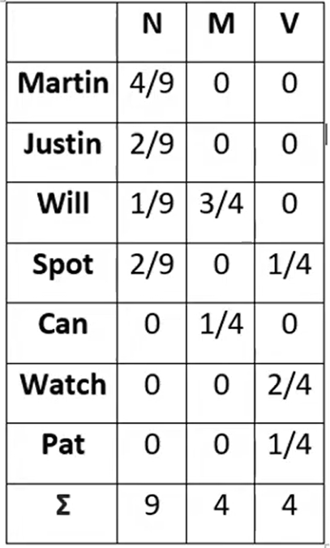
GenerativeAI and Its Applications
POS Tag using HMM

Slide 34
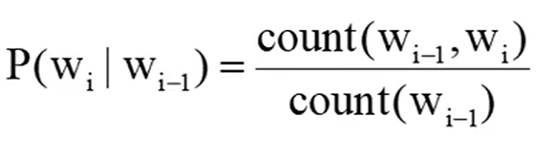
GenerativeAI and Its Applications
POS Tag using HMM

Slide 35
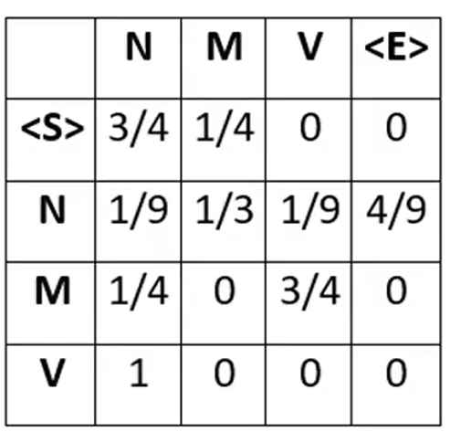
GenerativeAI and Its Applications
POS Tag using HMM

Slide 36
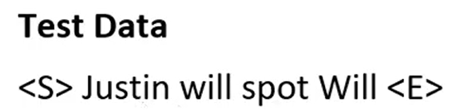
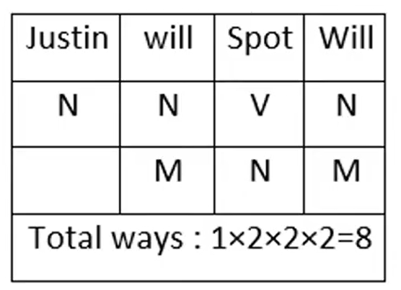
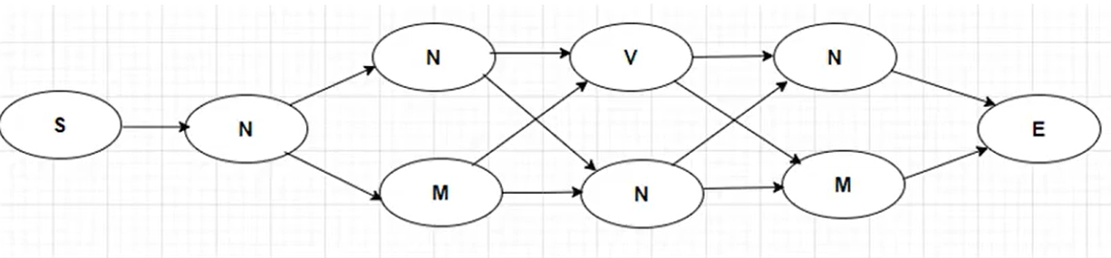
GenerativeAI and Its Applications
POS Tag using HMM

Slide 37
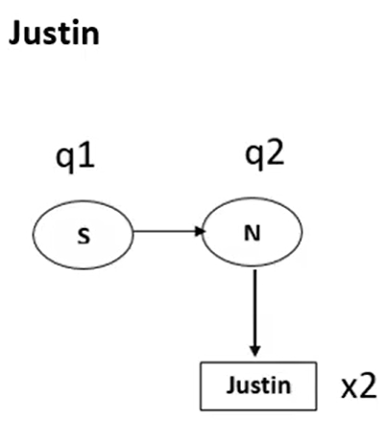
GenerativeAI and Its Applications
POS Tag using HMM

Slide 38
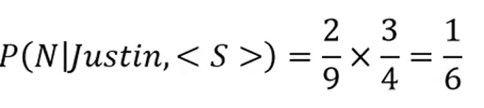
GenerativeAI and Its Applications
POS Tag using HMM

Slide 39

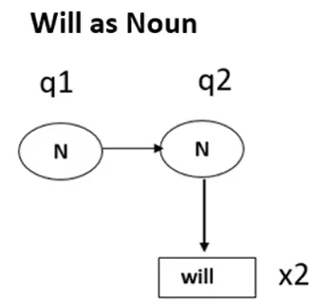
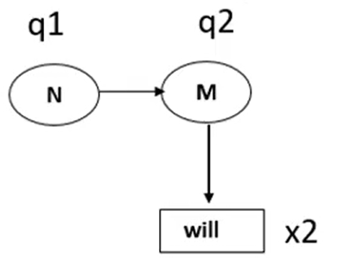
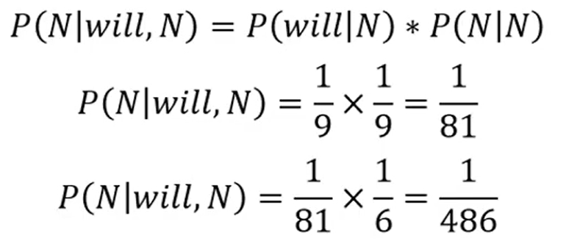
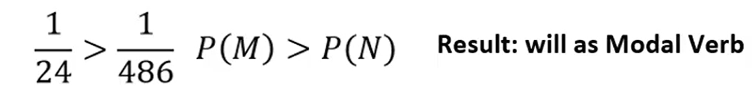
GenerativeAI and Its Applications
POS Tag using HMM

Slide 40
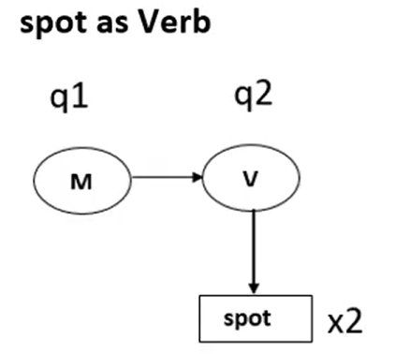
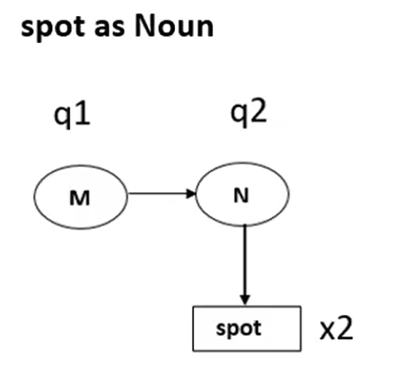
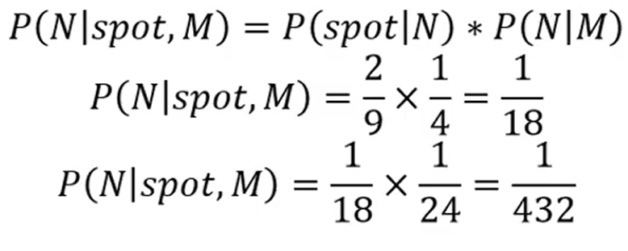
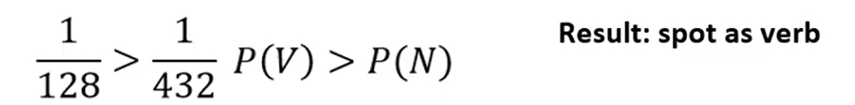
GenerativeAI and Its Applications
POS Tag using HMM

Slide 41
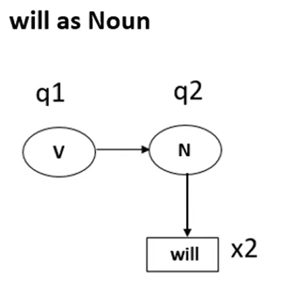
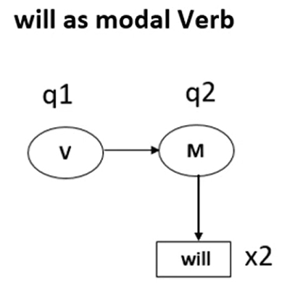
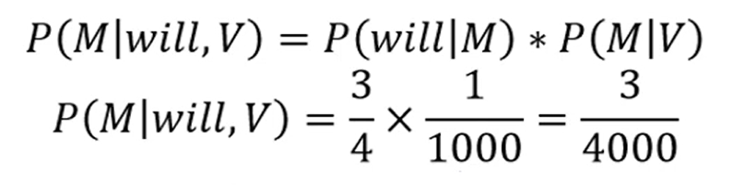
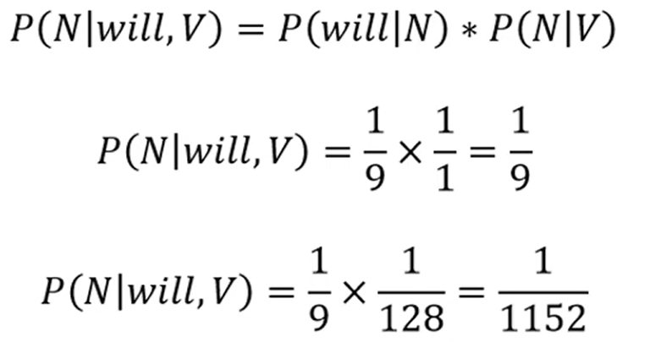
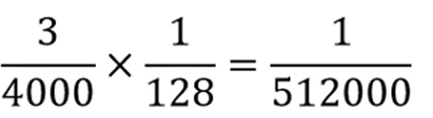


GenerativeAI and Its Applications
POS Tag using HMM

Slide 42
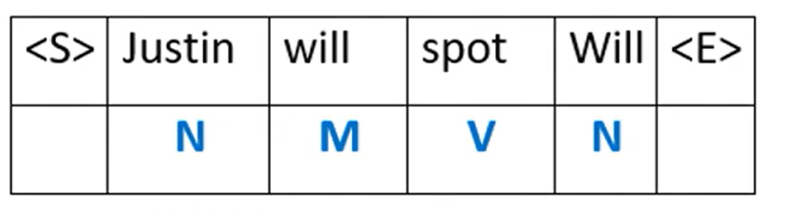
GenerativeAI and Its Applications
POS Tag using HMM

Slide 43
GenerativeAI and Its Applications
Named Entity Recognition(NER)

Slide 44
GenerativeAI and Its Applications
Information Extraction (IE)
Information extraction is an area of NLP that deals with finding factual information in free text.
In formal terms, facts are structured objects, such as database records. Such a record may capture a real-world entity with its attributes, with its arguments or actors: who did what to whom, where and when.
Information is typically sought in a particular target setting, e.g. corporate mergers and acquisitions etc.

Slide 45
GenerativeAI and Its Applications
An Example Information Extraction
Three bombs have exploded in north-eastern Nigeria, killing 25 people and wounding 12 in an attack carried out by Terrorist group. Authorities said the bombs exploded on Sunday afternoon in the city of Maiduguri
:Information extracted :
TYPE : Crisis ; SUBTYPE : BOMBING ; LOCATION : Maiduguri
DEAD-COUNT : 25 ; INJURED-COINT : 12 ;
PERPETRATOR : Terrorist group; WEAPONS : Bomb
TIME: Sunday afternoon

Slide 46
GenerativeAI and Its Applications
Applications of IE
Provides dramatic improvements in the conversion of the raw textual information into structured data and are increasingly being deployed in commercial applications.
Can constitute a core component in many other NLP applications i.e. Machine Translation, Question Answering, Text Summarization, Opinion Mining etc.

Slide 47
GenerativeAI and Its Applications
Classic Task of IE
Classic Tasks of IE
NER
Co-reference Resolution
Relation Extraction
Event Extraction

Slide 48
GenerativeAI and Its Applications
Classic IE Tasks : Named Entity Recognition
Addresses the problem of the identification (detection) and classification of predefined types of named entities, such as organizations (e.g., ‘World Health Organisation’), persons (e.g., ‘Muammar Kaddafi’), place names (e.g., ‘the Baltic Sea’), temporal expressions (e.g., ‘1 September 2011’), numerical and currency expressions (e.g., ‘20 Million Euros’) etc.
NER task can additionally include extracting descriptive information from the text about the detected entities through filling of a small-scale template.
For example, in the case of persons, it may include extracting the title, position, nationality, sex, and other attributes of the person

Slide 49
GenerativeAI and Its Applications
Classic IE Tasks: Co-reference Resolution
It requires the identification of multiple (co-referring) mentions of the same entity in the text.
Entity mention can be :
Named, in case an entity is referred to by name; e.g., ‘General Electric’ and ‘GE’.
Pronominal, in case an entity is referred to with a pronoun; e.g., in ‘John bought food. But he forgot to buy drinks.’, the pronoun he refers to John. Here he is the named entity and its pronominal.
Nominal, in case an entity is referred to with a nominal phrase; e.g., in ‘Microsoft revealed its earnings. The company also unveiled future plans.’ the definite noun phrase The company is a nominal phrase that refers to Microsoft.
Implicit, as in case of using zero-anaphora. Prime minister has visited the place of disaster. [He] flew over with a helicopter

Slide 50
GenerativeAI and Its Applications
Classic IE Tasks: Relation Extraction
Relation Extraction is the task of detecting and classifying predefined relationships between entities identified in text.
Example: EmployeeOf (Steve Jobs, Apple): a relation between a person and an organisation, extracted from ‘Steve Jobs works for Apple’
LocatedIn (Smith, New York): a relation between a person and location, extracted from ‘Mr. Smith gave a talk at the conference in New York’

Slide 51
GenerativeAI and Its Applications
Classic IE Tasks : Event Extraction
Event Extraction refers to the task of identifying events in free text and deriving detailed and structured information about them, ideally identifying who did what to whom, when, where, through what methods (instruments) and why.
Usually, event extraction involves extraction of several entities and relationships between them.
Example: The extraction of information on new joint ventures, where the aim is to identify the partners, products, profits and capitalization of the joint venture.
EE is considered to be the hardest of the four IE tasks

Slide 52

GenerativeAI and Its Applications
What is Named Entity and Named Entity Recognition
A named entity is anything that can be referred to with a proper name: a person, a location, an organization.
The task of named entity recognition (NER) is to find spans of text that constitute proper names and tag the type of named entity recognition NER the entity.
Four entity tags are most common:
PER (person),
LOC (location),
ORG (organization), or
GPE (geo-political entity).
However, the term named entity is commonly extended to include things that aren’t entities like, dates, times, and other kinds of temporal expressions, and even numerical expressions like prices.

Slide 53

GenerativeAI and Its Applications
NER Example
Citing high fuel prices, [_{ORG} United Airlines] said [_{TIME} Friday] it has increased fares by [_{MONEY} $6] per round trip on flights to some cities also served by lower-cost carriers. [_{ORG} American Airlines], a unit of [_{ORG} AMR Corp.], immediately matched the move, spokesman [_{PER} Tim Wagner] said. [_{ORG} United], a unit of [_{ORG} UAL Corp.], said the increase took effect [_{TIME} Thursday] and applies to most routes where it competes against discount carriers, such as [_{LOC} Chicago] to [_{LOC} Dallas] and [_{LOC} Denver] to [_{LOC} San Francisco].
A list of generic named entity types with the kinds of entities they refer to.

Slide 54

GenerativeAI and Its Applications
NER
In POS tagging, there is no segmentation problem since each word gets one tag.
But for NER one has to find and label spans of text, and its difficult because of the ambiguity of segmentation; we need to decide what’s an entity and what isn’t, and where the boundaries are.

Slide 55
GenerativeAI and Its Applications
Named Entity and a Named entity
Hotel & Taj Hotel
Flower & Rose Flower
Beach & Kovalam Beach
Airport & Indira Gandhi International airport
The School & Good Shepherd School
Prime Minister & Mr. Narendra Modi

Slide 56
GenerativeAI and Its Applications
Some problems in identifying NE
Variation of NE (same entity in different form).
Mahatama Gandhi, Gandhi , Bapu
Ambiguity of NE types:
1945 (date vs. time)
Washington (location vs. person)
May (person vs. month)
Tata (person vs. organization)
Person vs Location
Sir C. P Ramaswamy was the Divan of Travancore (Per)
Sir C.P Ramaswamy Road is in Chennai (Loc)
Person vs Organization
Anil Ambani opened Reliance Fresh (Per)
Reliance Fresh is under Anil Amabani Group Ltd (Org)

Slide 57
GenerativeAI and Its Applications
Entity name types (ENAMEX Subtypes)
Persons are entities limited to humans. Individual refer to names of each individual person. Group refers to set of individual
Location entities are limited to geographical entities such as geographical areas like names of countries, cities, continents and landmasses, bodies of water, and geological formations.
Organization entities are limited to corporations, agencies, and other groups of people defined by an established organizational structure
Entertainment entities denote activities, which divert and hold human attention or interest, giving pleasure, happiness, amusement especially performance of some kind such as dance, music, sports, events.
En: [Robin]_{PERSON} is working at [HCL]_{ORGANIZATION ,} which is in [Chennai] _{LOCATION}
En: [Flower Exhibition] _{ENTERTAINMENT} is held at [Hyderabad]_{LOCATION}

Slide 58
GenerativeAI and Its Applications
Entity name types (ENAMEX Subtypes)
Facilities are limited to buildings and other permanent man-made structures and real estate improvements like hospitals, airport, colleges, libraries etc.
A locomotive entity is a physical device primarily designed to move an object from one location to another, by carrying, pulling, or pushing the transported object.
Artifact entities are objects or things, produced or shaped by human craft, such as tools, weapons/ammunition, art paintings, clothes, ornaments, medicines
En: [Apolo Hospital] _{FACILITY} is in [Chennai] _{LOCATION}
En: [Bangalore Express]_{LOCOMOTIVE} departs from [Chennai] _{LOCATION} at
[7.30pm] _{Time}.
En: [Vinayaga Statue] _{ARTIFACT} is looking beautiful.

Slide 59
GenerativeAI and Its Applications
Entity name types
8. Materials refer to the names of food items, cuisines, chemicals and cosmetics
9. ORGANISMS are the names of different animal species including birds, reptiles, viruses, bacteria and names of herbs, medicinal plants, shrubs, trees, fruits, flowers etc.
10. Disease are names of disease, symptoms, diagnosis and treatments.

Slide 60
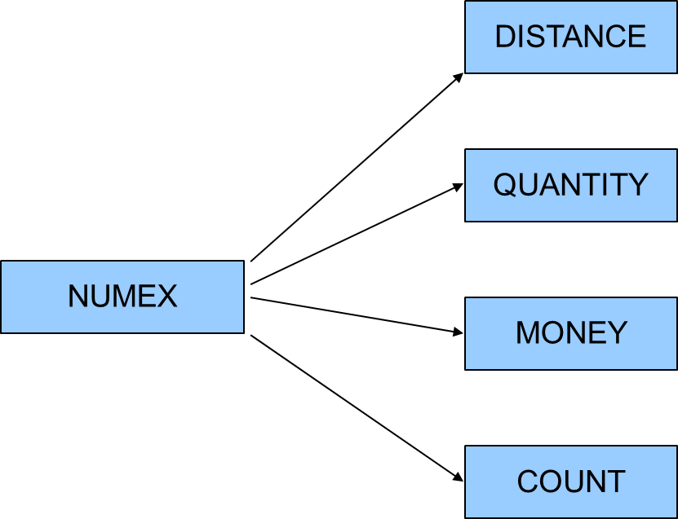
GenerativeAI and Its Applications
Numerical expression

Slide 61
GenerativeAI and Its Applications
Numerical expressions
Distance refers to the distance measures such as kilometers, Centimeters, meters, acres, feet etc.
Example: 10 cm., twenty feet, 15 hectares
Money specifies the different currency value such as rupee, euro, Dinar, dollar etc.
Example: Rs. 1000, 250 Euro, $160
Count denotes the number (or counts) of Items/ articles/things etc.
Example: 5 subjects, 12 students, 20 books
Quantity measurements like liters, tons, grams, volts etc. are comes under this category.
Example: 20 litres, 22 kg, 50g, 100 volts

Slide 62
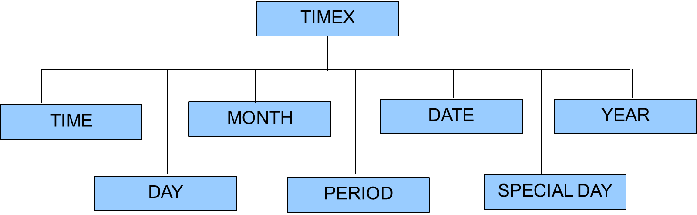
GenerativeAI and Its Applications
Time Expressions

Slide 63
GenerativeAI and Its Applications
Temporal Expressions
Temporal expressions are the entities refers to time, date, year, month and day
Time: These refer to expressions of time, includes different forms
of expressing time. This also includes Hours, minutes and seconds.
5’o clock in the morning
9.30 a.m.
Evening 6.30 p.m.
Date: This refers to expressions of Date such as 13/12/2001 etc in
different forms. This also includes month, date and year
August 15 1947
1956
September 11

Slide 64
GenerativeAI and Its Applications
Temporal Expressions
Period: refers to expressions, which express duration of time or
time periods or time intervals.
Example
17 th century
10 minutes
10 a.m. to 12 p.m.
One year

Slide 65
GenerativeAI and Its Applications
Nested or embedded entity
Nested Entities: Refers to the named entities which occurs within another named entities. Also called as embedded entities.
En: Madurai Meenakshi Temple
En: Lalu Prasad Yadav
En : Nitoor Srinivasa rao
En : Rajeev Gandhi Salai

Slide 66
GenerativeAI and Its Applications
Nested or embedded entity
Entities can be
Person
Location
Organization
Date
Product
Fruit
Sridhar wants to buy Apple phone in India on January 16, 2025.

Slide 67
GenerativeAI and Its Applications
Nested or embedded entity
Entities can be
Person
Location
Organization
Date
Product
Fruit
Sridhar wants to buy Apple phone in India on January 16, 2025.

Slide 68
Thank You

